Slide 1
Chapter 5: Thread-Level Parallelism
5.1 Introduction
parallel processors will definitely have a bigger role in the future：
    the logical way is by connecting multiple microprocessors together.
    the pace of architectural innovation
    steady progress on parallel software.
Computer School, NUDT. Fall, 2018

Slide 2
  Growing interest in high-end servers
  Growth in data-intensive applications
  Increasing desktop performance is less important
  Improved understanding in how to use multiprocessors effectively
  Advantage of leveraging design investment by replication
Focus on the mainstream of multiprocessor design: multiprocessors with small to medium numbers of processors.
Computer School, NUDT. Fall, 2018

Slide 3
A Taxonomy of Parallel Architectures
About 30 years ago, Flynn proposed a simple model of categorizing all computers that is still useful today.
1.Single instruction stream, single data stream (SISD)
2.Single instruction stream, multiple data streams (SIMD)
3.Multiple instruction streams, single data stream (MISD)
4.Multiple instruction streams, multiple data streams(MIMD)
Computer School, NUDT. Fall, 2018

Slide 4
MIMD has clearly emerged as the architecture of choice for general-purpose multiprocessors. Two factors are primarily responsible for the rise of the MIMD multiprocessors:
1. MIMDs offer flexibility. With the correct hardware and software support, MIMDs can function as single-user multiprocessors focusing on high performance for one application, as multiprogrammed multiprocessors running many tasks simultaneously, or as some combination of these functions.
Computer School, NUDT. Fall, 2018

Slide 5
2. MIMDs can build on the cost/performance advantages of off-the-shelf microprocessors. In fact, nearly all multiprocessors built today use the same microprocessors found in workstations and single-processor servers.
We difine multiprocessors as computers consisting of tightly coupled processors whose coordination and usage are typically controlled by a single operating system and that share memory through a shared address space.
Computer School, NUDT. Fall, 2018

Slide 6
Exploit thread-level parallelism thrugh two different software models:
1.Execution of a tightly coupled set of threads collabrating on a sigle task, tylically called parallel processing
2.Execution of multiple, relative independent processes that may originate from one or more usres, which is a form of request-level parallelism
Computer School, NUDT. Fall, 2018

Slide 7
Starting in the 1990s, the increasing capacity of a single chip allowed designers to place multiple processors on a single die. This approach, initially called on-chip multiprocessing or single-chip multiprocessing, has come to be called multicore, a name arising from the use of multiple processor core on a single die.
In such a design, the multiple cores typically share some resources,such as a second- or third-level cache or memory and I/O bus.
Computer School, NUDT. Fall, 2018

Slide 8
It is also useful to be able to have multiple processors executing a single program and sharing the code and most of their address space. When multiple processes share code and data in this way, they are often called Threads .
Computer School, NUDT. Fall, 2018

Slide 9
To take advantage of an MIMD multiprocessor with n processors, we must usually have at least n threads or processes to execute.
The independent threads are typically identified by the programmer or created by the compiler. Since the parallelism in this situation is contained in the threads, it is called thread-level parallelism.
Computer School, NUDT. Fall, 2018

Slide 10
Existing MIMD multiprocessors fall into two classes, depending on the number of processors involved, which in turn dictate a memory organization and interconnect strategy.
1. centralized shared-memory architectures. For multiprocessors with small processor counts, it is possible for the processors to share a single centralized memory and to interconnect the processors and memory by a bus.
Computer School, NUDT. Fall, 2018

Slide 11
Because there is a single main memory that has a symmetric relationship to all processors and a uniform access time from any processor, these multiprocessors are often called symmetric (shared-memory) multiprocessors ( SMPs ), and this style of architecture is sometimes called UMA for uniform memory access.
This type of centralized shared-memory architecture is currently by far the most popular organization.
Computer School, NUDT. Fall, 2018

Slide 12
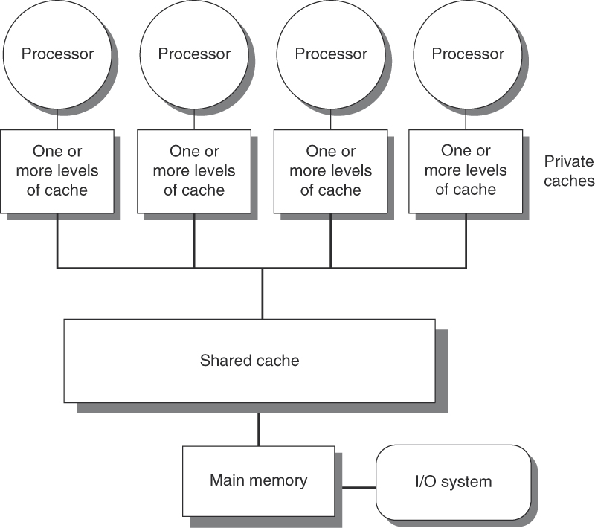
Figure 5.1 Basic structure of a centralized shared-memory multiprocessor based on a multicore chip.
Computer School, NUDT. Fall, 2018

Slide 13
2.Multiprocessors with physically distributed memory. To support larger processor counts, memory must be distributed among the processors rather than centralized; otherwise the memory system would not be able to support the bandwidth demands of a larger number of processors without incurring excessively long access latency.
Nodes containing a processor, some memory, typically some I/O, and an interface to an interconnection network that connects all the nodes.
Computer School, NUDT. Fall, 2018

Slide 14
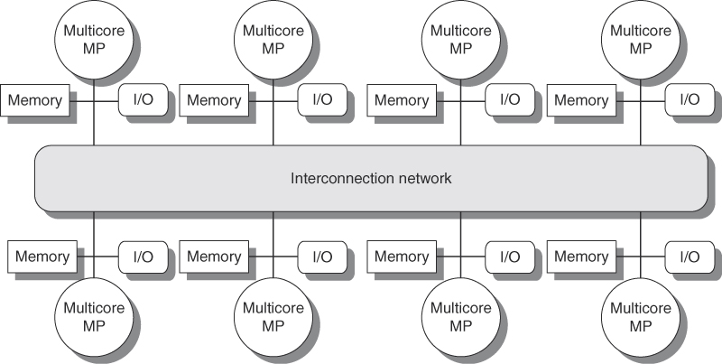
Figure 5.2 The basic architecture of a distributed-memory multiprocessor in 2011 typically consists of a multicore multiprocessor chip with memory and possibly I/O attached and an interface to an interconnection network that connects all the nodes.
Computer School, NUDT. Fall, 2018

Slide 15
Distributing the memory among the nodes has two major benefits:
1. It is a cost-effective way to scale the memory bandwidth, if most of the accesses are to the local memory in the node.
2. It reduces the latency for accesses to the local memory.
Computer School, NUDT. Fall, 2018

Slide 16
The key disadvantage for a distributed memory architecture is that communicating data between processors becomes somewhat more complex and has higher latency.
Typically, I/O as well as memory is distributed among the nodes of the multiprocessor, and the nodes may be small SMPs (2 –8 processors).
We will focus on the one-processor-per-node design for most of this chapter.
Computer School, NUDT. Fall, 2018

Slide 17
Models for Communication and Memory Architecture
There are two alternative architectural approaches that differ in the method used for communicating data among processors:
1. Communication occurs through a shared address space. The physically separate memories can be addressed as one logically shared address space,
Computer School, NUDT. Fall, 2018

Slide 18
A memory reference can be made by any processor to any memory location, These multiprocessors are called distributed shared-memory ( DSM ) architectures.
The DSM multiprocessors are also called NUMAs, non-uniform memory access , since the access time depends on the location of a data word in memory.
Computer School, NUDT. Fall, 2018

Slide 19
2.The address space can consist of multiple private address spaces that are logically disjoint and cannot be addressed by a remote processor. In such multiprocessors, the same physical address on two different processors refers to two different locations in two different memories.
Each processor-memory module is essentially a separate computer; therefore these parallel processors have been called multicomputers.
A multicomputer can even consist of completely separate computers connected on a local area network, which, today, are popularly called clusters.
Computer School, NUDT. Fall, 2018

Slide 20
Communication mechanism:
For a multiprocessor with a shared address space, that address space can be used to communicate data implicitly via load and store operations; hence the name shared memory for such multiprocessors.
For a multiprocessor with multiple address spaces, communication of data is done by explicitly passing messages among the processors. Therefore, these multiprocessors are often called message passing multiprocessors.
Computer School, NUDT. Fall, 2018

Slide 21
This type of message passing is also called synchronous, since the initiating processor sends a request and waits until the reply is returned before continuing.
Communication can also occur from the viewpoint of the writer of data rather than the reader, and this can be more efficient when the processor producing data knows which other processors will need the data.
Computer School, NUDT. Fall, 2018

Slide 22
In such cases, the data can be sent directly to the consumer process without having to be requested first. It is often possible to perform such message sends asynchronously,
To ease program portability, standard message passing libraries (for example, message passing interface, or MPI) have been proposed. Such libraries sacrifice some performance to achieve a common interface.
Computer School, NUDT. Fall, 2018

Slide 23
Performance Metrics for Communication Mechanisms
Three performance metrics are critical in any communication mechanism:
1.Communication bandwidth—Ideally the communication bandwidth is limited by processor, memory, and interconnection bandwidths,
2.Communication latency—Ideally the latency is as low as possible. Communication latency is equal to:
Sender overhead + Time of flight +Transmission time + Receiver overhead
Computer School, NUDT. Fall, 2018

Slide 24
3.Communication latency hiding—How well can the communication mechanism hide latency by overlapping communication with computation or with other communication?
Each of these performance measures is affected by the characteristics of the communications needed in the application.
Computer School, NUDT. Fall, 2018

Slide 25
Advantages of Different Communication Mechanisms
Each of these two primary communication mechanisms has its advantages. For shared-memory communication, advantages include:
  Compatibility with the well-understood mechanisms in use in centralized multiprocessors, which all use shared-memory communication.
  Ease of programming when the communication patterns among processors are complex or vary dynamically during execution. Similar advantages simplify compiler design.
Computer School, NUDT. Fall, 2018

Slide 26
  The ability to develop applications using the familiar shared-memory model, focusing attention only on those accesses that are performance critical.
  Lower overhead for communication and better use of bandwidth when communicating small items. This arises from the implicit nature of communication and the use of memory mapping to implement protection in hardware, rather than through the I/O system.
  The ability to use hardware-controlled caching to reduce the frequency of remote communication by supporting automatic caching of all data, both shared and private.
Computer School, NUDT. Fall, 2018

Slide 27
The major advantages for message-passing communication include:
  The hardware can be simpler, especially by comparison with a scalable shared memory implementation that supports coherent caching of remote data.
  Communication is explicit, which means it is simpler to understand; in shared memory models, it can be difficult to know when communication is occurring and when it is not, as well as how costly the communication is.
Computer School, NUDT. Fall, 2018

Slide 28
  Explicit communication focuses programmer attention on this costly aspect of parallel computation, sometimes leading to improved structure in a multiprocessor program.
  Synchronization is naturally associated with sending messages, reducing the possibility for errors introduced by incorrect synchronization.
  It makes it easier to use sender-initiated communication, which may have some advantages in performance.
Computer School, NUDT. Fall, 2018

Slide 29
Supporting message passing on top of shared memory is considerably easier: Because messages essentially send data from one memory to another, sending a message can be implemented by doing a copy from one portion of the address space to another.
Supporting shared memory efficiently on top of hardware for message passing is much more difficult. Without explicit hardware support for shared memory, all shared-memory references need to translation and memory protection, as well as to translate memory references into message sends and receives.
Computer School, NUDT. Fall, 2018

Slide 30
SMPs, which we focus on in Section 6.3, vastly dominate DSM multiprocessors in terms of market size (both units and dollars), and SMPs will probably be the architecture of choice for on-chip multiprocessors.
For moderate scale multiprocessors (>8 processors) long-term technical trends favor distributing memory, which is also likely to be the dominant approach when on-chip SMPs are used as the building blocks in the future.
Computer School, NUDT. Fall, 2018

Slide 31
Challenges of Parallel Processing
Two important hurdles, both explainable with Amdahl’s Law, make parallel processing challenging.
1.Has to do with the limited parallelism available in programs.
2.Arises from the relatively high cost of communications.
Computer School, NUDT. Fall, 2018

Slide 32

EXAMPLE
Suppose you want to achieve a speedup of 80 with 100 rocessors. What fraction of the original computation can be sequential?
ANSWER
Amdahl’s Law is
Computer School, NUDT. Fall, 2018

Slide 33
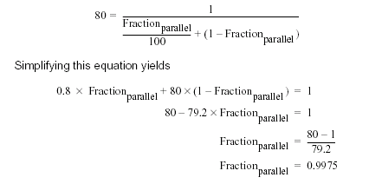
Computer School, NUDT. Fall, 2018

Slide 34
Example :
Suppose we have an application running on a 100-processor multiprocessor, and assume that application can use 1, 50, or 100 processors. If we assume that 95% of the time we can use all 100 processors, how much of the remaining 5% of the execution time must employ 50 processors if we want a speedup of 80?
Computer School, NUDT. Fall, 2018

Slide 35
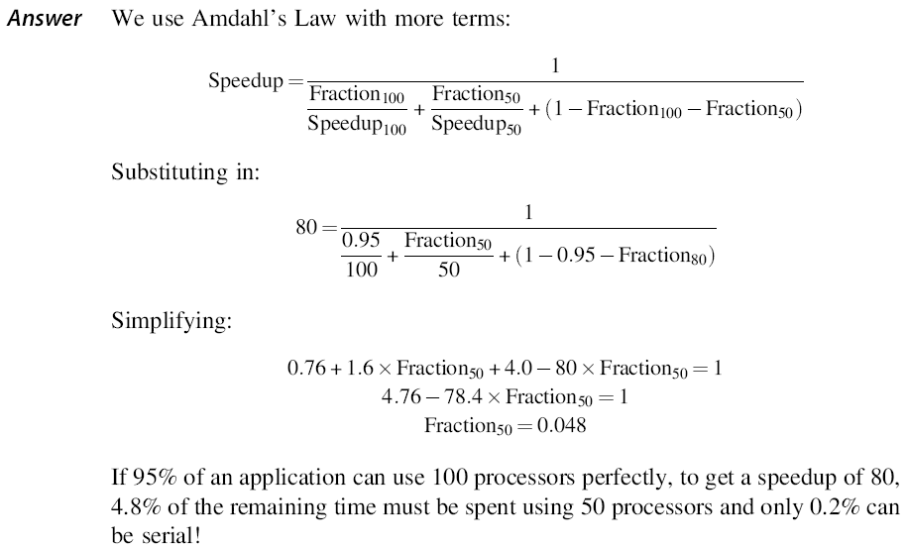
Computer School, NUDT. Fall, 2018

Slide 36
EXAMPLE:
Suppose we have an application running on a 32-processor multiprocessor that has a 100 ns delay to handle a reference to a remote memory. For this application, assume that all the references except those involving communication hit in the
local memory hierarchy, which is obviously optimistic. Processors are stalled on a remote request, and the processor clock rate is 4 GHz. If the base CPI (assuming
that all references hit in the cache) is 0.5, how much faster is the multiprocessor if there is no communication versus if 0.2% of the instructions involve a remote communication reference?
Computer School, NUDT. Fall, 2018

Slide 37
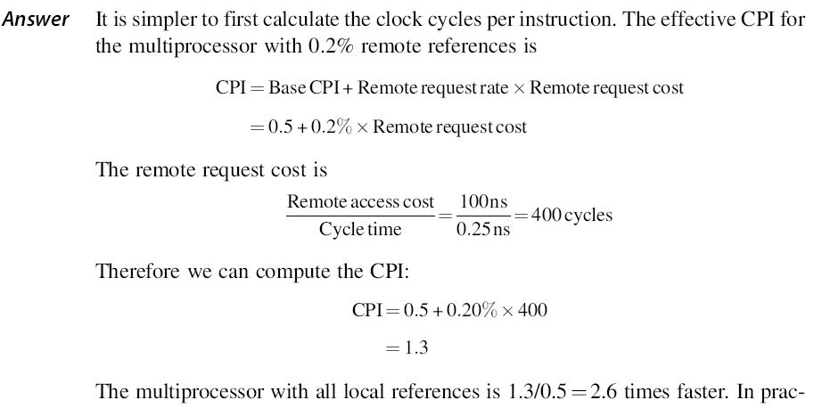
Computer School, NUDT. Fall, 2018

Slide 38
Characteristics of Application Domains
In parallel processing, the additional performance-critical characteristics—such as load balance, synchronization, and sensitivity to memory latency—typically depend on high-level characteristics of the application.
These characteristics include factors like how data is distributed, the structure of a parallel algorithm, and the spatial and temporal access patterns to data. Therefore at this point we take the time to examine the three different classes of workloads.
Computer School, NUDT. Fall, 2018

Slide 39
A Commercial Workload
Our commercial workload consists of three applications:
  1. An online transaction processing workload (OLTP)
  2. A decision support system (DSS)
  3. A web index search (Altavista) benchmark
Multiprogramming and OS Workload
For small-scale multiprocessors we will also look at a multiprogrammed workload consisting of both user activity and OS activity.
Computer School, NUDT. Fall, 2018

Slide 40
Scientific/Technical Applications
Two applications and two computational kernels:
The kernels are an FFT (fast Fourier transformation) and an LU decomposition, which were chosen because they represent commonly used techniques in a wide variety of applications and have performance characteristics typical of many parallel scientific applications.
The two applications that we use in this chapter are Barnes and Ocean, which represent two important but very different types of parallel computation.
Computer School, NUDT. Fall, 2018

Slide 41
Computation/Communication for the Parallel Programs
A key characteristic in determining the performance of parallel programs is the ratio of computation to communication. If the ratio is high, it means the application has lots of computation for each datum communicated.
How the ratio of computation to communication changes as we increase either the number of processors, the size of the problem, or both.
Computer School, NUDT. Fall, 2018

Slide 42
To understand what happens quantitatively to the computation-to-communication ratio as we add processors, consider what happens separately to computation and to communication as we either add processors or increase problem size.
Communication scaling is more complex and depends on details of the algorithm;
The overall computation-to-communication ratio is computed from the individual growth rate in computation and communication. In general, this ratio rises slowly with an increase in data set size and decreases as we add processors.
Computer School, NUDT. Fall, 2018

Slide 43
EXAMPLE Suppose we know that for a given multiprocessor the Ocean application spends 20% of its execution time waiting for communication when run on four processors. Assume that the cost of each communication event is independent on processor count, which is not true in general, since communication costs rise with processor count. How much faster might we expect Ocean to run on a 32-processor machine with the same problem size? What fraction of the execution time is spent on communication in this case? How much larger a problem should we run if we want the fraction of time spent communicating to be the same?
Computer School, NUDT. Fall, 2018

Slide 44
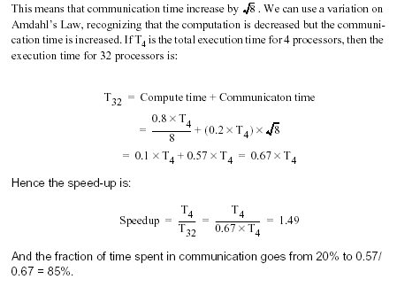
Computer School, NUDT. Fall, 2018

Slide 45
5.2 Centralized Shared-Memory Architectures
Small-scale shared-memory machines usually support the caching of both shared and private data. Private data is used by a single processor, while shared data is used by multiple processors, essentially providing communication among the processors through reads and writes of the shared data.
Computer School, NUDT. Fall, 2018

Slide 46
When shared data are cached, the shared value may be replicated in multiple caches.
In addition to the reduction in access latency and required memory bandwidth, this replication also provides a reduction in contention that may exist for shared data items that are being read by multiple processors simultaneously.
Caching of shared data introduces a new problem: cache coherence.
Computer School, NUDT. Fall, 2018

Slide 47
What Is Multiprocessor Cache Coherence?
the introduction of caches caused a coherence problem for I/O operations, since the view of memory through the cache could be different from the view of memory.
This difficulty is generally referred to as the cache-coherence problem.
Computer School, NUDT. Fall, 2018

Slide 48
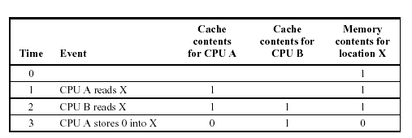
Computer School, NUDT. Fall, 2018

Slide 49
Informally, we could say that a memory system is coherent if any read of a data item returns the most recently written value of that data item.
This simple definition contains two different aspects of memory system behavior, both of which are critical to writing correct shared-memory programs.
1.Coherence, defines what values can be returned by a read.
2. Consistency, determines when a written value will be returned by a read.
Computer School, NUDT. Fall, 2018

Slide 50
A memory system is coherent if
1. A read by a processor, P, to a location X that follows a write by P to X, with no writes of X by another processor occurring between the write and the read by P, always returns the value written by P.
2. A read by a processor to location X that follows a write by another processor to X returns the written value if the read and write are sufficiently separated in time and no other writes to X occur between the two accesses.
Computer School, NUDT. Fall, 2018

Slide 51
3. Writes to the same location are serialized: that is, two writes to the same location by any two processors are seen in the same order by all processors. For example, if the values 1 and then 2 are written to a location, processors can never read the value of the location as 2 and then later read it as 1.
Computer School, NUDT. Fall, 2018

Slide 52
Coherence and consistency are complementary: Coherence defines the behavior of reads and writes to the same memory location, while consistency defines the behavior of reads and writes with respect to accesses to other memory locations.
For simplicity, assume that we require that a write does not complete until all processors have seen the effect of the write and that the processor does not change the order of any write with any other memory access. This allows the processor to reorder reads, but forces the processor to finish a write in program order.
Computer School, NUDT. Fall, 2018

Slide 53
Basic Schemes for Enforcing Coherence
In a coherent multiprocessor, the caches provide both migration and replication of shared data items.
Coherent caches provide migration, since a data item can be moved to a local cache and used there in a transparent fashion. This migration reduces both the latency to access a shared data item that is allocated remotely and the bandwidth demand on the shared memory.
Computer School, NUDT. Fall, 2018

Slide 54
Coherent caches also provide replication for shared data that is being simultaneously read, since the caches make a copy of the data item in the local cache. Replication reduces both latency of access and contention for a read shared data item.
The protocols to maintain coherence for multiple processors are called cache-coherence protocols. Key to implementing a cache-coherence protocol is tracking the state of any sharing of a data block. There are two classes of protocols, which use different techniques to track the sharing status, in use:
Computer School, NUDT. Fall, 2018

Slide 55
1. Directory based---The sharing status of a block of physical memory is kept in just one location, called the directory; we focus on this approach when we discuss scalable shared-memory architecture.
2.Snooping---Every cache that has a copy of the data from a block of physical memory also has a copy of the sharing status of the block, and no centralized state is kept. The caches are usually on a shared-memory bus, and all cache controllers monitor or snoop on the bus to determine whether or not they have a copy of a block that is requested on the bus.
Computer School, NUDT. Fall, 2018

Slide 56
Snooping Protocols
There are two ways to maintain the coherence requirement :
1. To ensure that a processor has exclusive access to a data item before it writes that item. This style of protocol is called a write invalidate protocol because it invalidates other copies on a write. It is by far the most common protocol, both for snooping and for directory schemes. Exclusive access ensures that no other readable or writable copies of an item exist when the write occurs: all other cached copies of the item are invalidated.
Computer School, NUDT. Fall, 2018

Slide 57
For a write, we require that the writing
processor have exclusive access, preventing any other processor from being able to write simultaneously.
If two processors do attempt to write the same data simultaneously, one of them wins the race, causing the other processor copy to be invalidated. For the other processor to complete its write, it must obtain a new copy of the data, which must now contain the updated value. Therefore, this protocol enforces write serialization.
Computer School, NUDT. Fall, 2018

Slide 58
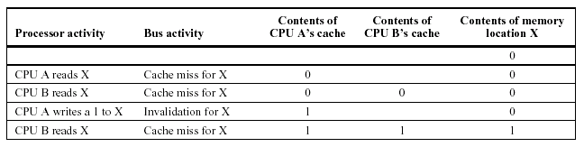
Computer School, NUDT. Fall, 2018

Slide 59
2. To update all the cached copies of a data item when that item is written. This type of protocol is called a write update or write broadcast protocol.
Computer School, NUDT. Fall, 2018

Slide 60
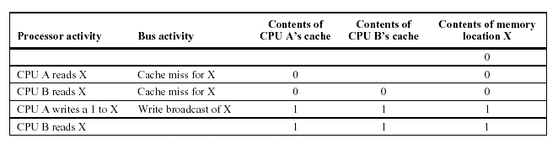
Computer School, NUDT. Fall, 2018

Slide 61
The performance differences between write update and write invalidate protocols arise from three characteristics:
1. Multiple writes to the same word with no intervening reads require multiple write broadcasts in an update protocol, but only one initial invalidation in a write invalidate protocol.
Computer School, NUDT. Fall, 2018

Slide 62
2. With multiword cache blocks, each word written in a cache block requires a write broadcast in an update protocol, although only the first write to any word in the block needs to generate an invalidate in an invalidation protocol.
An invalidation protocol works on cache blocks, while an update protocol must work on individual words (or bytes, when bytes are written).
Computer School, NUDT. Fall, 2018

Slide 63
3. The delay between writing a word in one processor and reading the written value in another processor is usually less in a write update scheme, since the written data are immediately updated in the reader’s cache (assuming that the reading processor has a copy of the data).
Because bus and memory bandwidth is usually the commodity most in demand in a bus-based multiprocessor and invalidation protocols generate less bus and memory traffic, invalidation has become the protocol of choice for almost all multiprocessors.
Computer School, NUDT. Fall, 2018

Slide 64
Basic Implementation Techniques
The key to implementing an invalidate protocol in a small-scale multiprocessor is the use of the bus to perform invalidates.
To perform an invalidate the processor simply acquires bus access and broadcasts the address to be invalidated on the bus. All processors continuously snoop on the bus watching the addresses. The processors check whether the address on the bus is in their cache. If so, the corresponding data in the cache is invalidated.
Computer School, NUDT. Fall, 2018

Slide 65
The serialization of access enforced by the bus also forces serialization of writes, since when two processors compete to write to the same location, one must obtain bus access before the other.
The first processor to obtain bus access will cause the other processor’s copy to be invalidated, causing writes to be strictly serialized.
One implication of this scheme is that a write to a shared data item cannot complete until it obtains bus access.
Computer School, NUDT. Fall, 2018

Slide 66
In a write-through cache, it is easy to find the recent value of a data item, since all written data are always sent to the memory, from which the most recent value of a data item can always be fetched.
For a write-back cache, the most recent value of a data item can be in a cache rather than in memory. Write-back caches can use the same snooping scheme both for caches misses and for writes: Each processor snoops every address placed on the bus. If a processor finds that it has a dirty copy of the requested cache block, it provides that cache block in response to the read request and causes the memory access to be aborted.
Computer School, NUDT. Fall, 2018

Slide 67
The normal cache tags can be used to implement the process of snooping, and the valid bit for each block makes invalidation easy to implement.
To track whether or not a cache block is shared we can add an extra state bit associated with each cache block, just as we have a valid bit and a dirty bit.
The processor with the sole copy of a cache block is normally called the owner of the cache block.
Computer School, NUDT. Fall, 2018

Slide 68
When an invalidation is sent, the state of the owner’s cache block is changed from shared to unshared (or exclusive). If another processor later requests this cache block, the state must be made shared again.
Since our snooping cache also sees any misses, it knows when the exclusive cache block has been requested by another processor and the state should be made shared.
Computer School, NUDT. Fall, 2018

Slide 69
Every bus transaction must check the cache-address tags, which could potentially interfere with CPU cache accesses. This potential interference is reduced by one of two techniques: duplicating the tags or employing a multilevel cache with inclusion, whereby the levels closer to the CPU are a subset of those further away.
If the tags are duplicated, then the CPU and the snooping activity may proceed in parallel.
With duplicate tags the processor only needs to be stalled when it does a cache access at the same time that a snoop has detected a copy in the cache.
Computer School, NUDT. Fall, 2018

Slide 70
If the CPU uses a multilevel cache with the inclusion property, then every entry in the primary cache is required to be in the secondary cache. Thus the snoop activity can be directed to the second-level cache, while most of the processor’s activity is directed to the primary cache.
Sometimes it may even be useful to duplicate the tags of the secondary cache to further decrease contention between the CPU and the snooping activity.
Computer School, NUDT. Fall, 2018

Slide 71
An Example Protocol
A bus-based coherence protocol is usually implemented by incorporating a finite state controller in each node. This controller responds to requests from the processor and from the bus, changing the state of the selected cache block, as well as using the bus to access data or to invalidate it.
For simplicity, the protocol we explain does not distinguish between a write hit and a write miss to a shared cache block: in both cases, we treat such an access as a write miss.
Computer School, NUDT. Fall, 2018

Slide 72
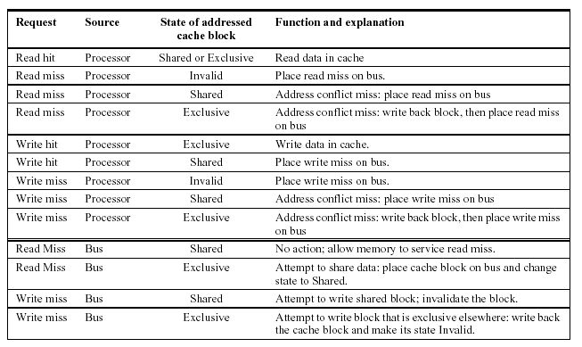
Computer School, NUDT. Fall, 2018

Slide 73
Treating write hits to shared blocks as cache misses reduces the number of different bus transactions and simplifies the controller.
In more sophisticated protocols, these “misses” are treated as upgrade requests that generate a bus transaction and an invalidate, but do not actually transfer the data, since the copy in he cache is up-to-date.
Computer School, NUDT. Fall, 2018

Slide 74
The most important of these is that the protocol assumes that operations are atomic--that is, an operation can be done in such a way that no intervening operation can occur.
Nonatomic actions introduce the possibility that the protocol can deadlock, meaning that it reaches a state where it cannot continue. Appendix I deals with these complex issues, showing how the protocol can be modified to deal with nonatomic writes without introducing deadlock.
Computer School, NUDT. Fall, 2018

Slide 75
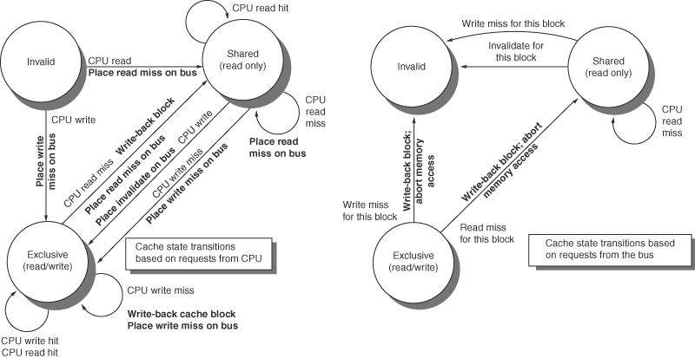
Figure 5.6 A write invalidate, cache coherence protocol for a private write-back cache showing the states and state transitions for each block in the cache
Computer School, NUDT. Fall, 2018

Slide 76
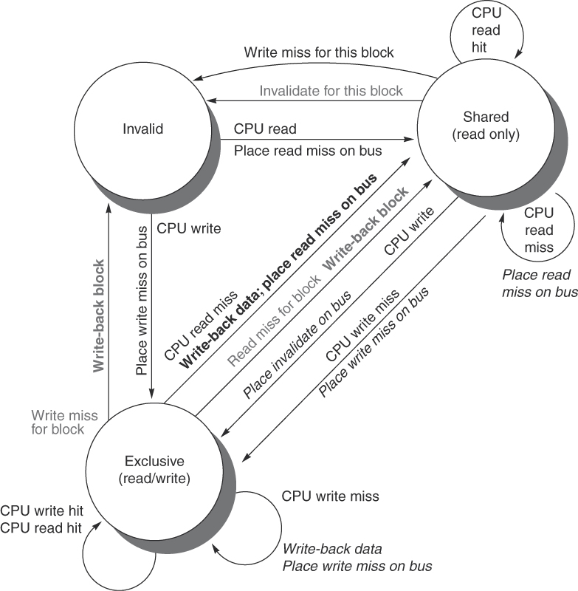
Figure 5.7 Cache coherence state diagram with the state transitions induced by the local processor shown in black and by the bus activities shown in gray. As in Figure 5.6, the activities on a transition are shown in bold.
Computer School, NUDT. Fall, 2018

Slide 77
As stated earlier, this coherence protocol is actually simpler than those used in practice. There are two major simplifications:
1. In this protocol all transitions to the exclusive state generate a write miss on the bus, and we assume that the requesting cache always fills the block with the contents returned. This simplifies the detailed implementation. Most real protocols distinguish between a write miss and a write hit, which can occur when the cache block is initially in the shared state.
Computer School, NUDT. Fall, 2018

Slide 78
2.Many multiprocessors distinguish between a cache block that is really shared and one that exists in the clean state in exactly one cache. This addition of a “clean and private” state eliminates the need to generate a bus transaction on a write to such a block. Another enhancement in wide use allows other caches to supply data on a miss to a shared block.
Computer School, NUDT. Fall, 2018

Slide 79
Many modern microprocessors provide basic support for cache coherency and also allow the construction of a shared memory bus by direct connection of the external memory bus of two processors.
These capabilities reduce the number of chips required to build a small-scale multiprocessor.
Computer School, NUDT. Fall, 2018

Slide 80
5.3 Performance of Symmetric Shared-Memory Multiprocessors
In a bus-based multiprocessor using an invalidation protocol, several different phenomena combine to determine performance. In particular, the overall cache performance is a combination of the behavior of uniprocessor cache miss traffic and the traffic caused by communication, which results in invalidations and subsequent cache misses.
The misses that arise from interprocessor communication, which are often called coherence misses, can be broken into two separate sources.
Computer School, NUDT. Fall, 2018

Slide 81
The first source are the so-called true sharing misses that arise from the communication of data through the cache coherence mechanism.
The second effect, called false sharing, arises from the use of an invalidation-based coherence algorithm with a single valid bit per cache block.
Computer School, NUDT. Fall, 2018

Slide 82
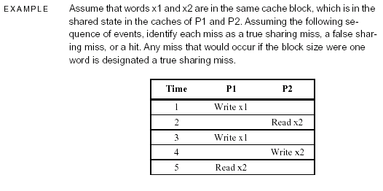
Computer School, NUDT. Fall, 2018

Slide 83
ANSWER Here are classifications by time step:
1. This event is a true sharing miss, since x1 was read by P2 and needs to be invalidated from P2.
2. This event is a false sharing miss, since x2 was invalidated by the write of x1 in P1, but that value of x1 is not used in P2.
3. This event is a false sharing miss, since the block containing x1 is marked shared due to the read in P2, but P2 did not read x1. The cache block containing x1 will be in the shared state after the read by P2; a write miss is required to obtain exclusive access to the block. In some protocols this will be handled as an upgrade request, which generates a bus invalidate, but does not transfer the cache block.
Computer School, NUDT. Fall, 2018

Slide 84
4. This event is a false sharing miss for the same reason as step 3.
5. This event is a true sharing miss, since the value being read was written by P2.
True sharing and false sharing miss rates can be affected by a variety of changes in the cache architecture. Thus, we will find it useful to decompose not only the uniprocessor and multiprocessor miss rates, but also the true-sharing and false-sharing miss rates.
Computer School, NUDT. Fall, 2018

Slide 85
Performance Measurements of the Commercial Workload
Computer School, NUDT. Fall, 2018

Slide 86
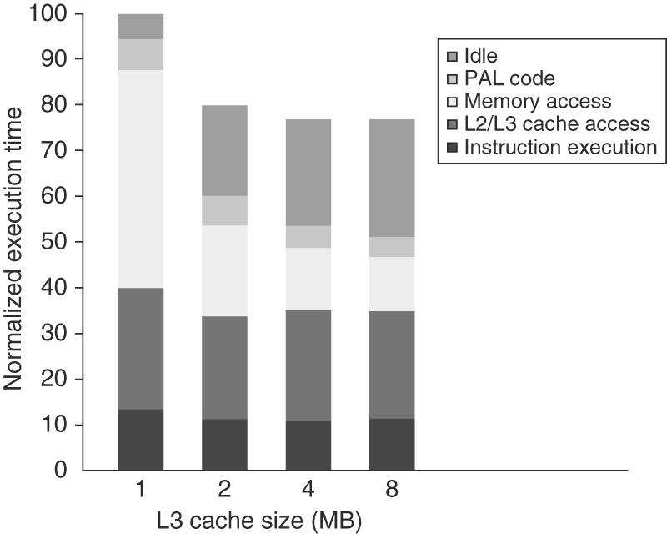
Figure 5.10 The relative performance of the OLTP workload as the size of the L3 cache, which is set as two-way set associative, grows from 1 MB to 8 MB. The idle time also grows as cache size is increased, reducing some of the performance gains. This growth occurs because, with fewer memory system stalls, more server processes are needed to cover the I/O latency. The workload could be retuned to increase the computation/communication balance, holding the idle time in check. The PAL code is a set of sequences of specialized OS-level instructions executed in privileged mode; an example is the TLB miss handler.
Computer School, NUDT. Fall, 2018

Slide 87
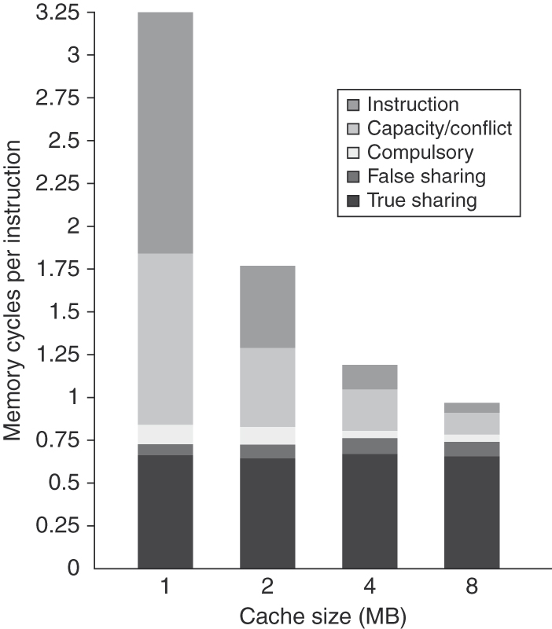
Figure 5.11 The contributing causes of memory access cycle shift as the cache size is increased. The
L3 cache is simulated as two-way set associative.
Computer School, NUDT. Fall, 2018

Slide 88
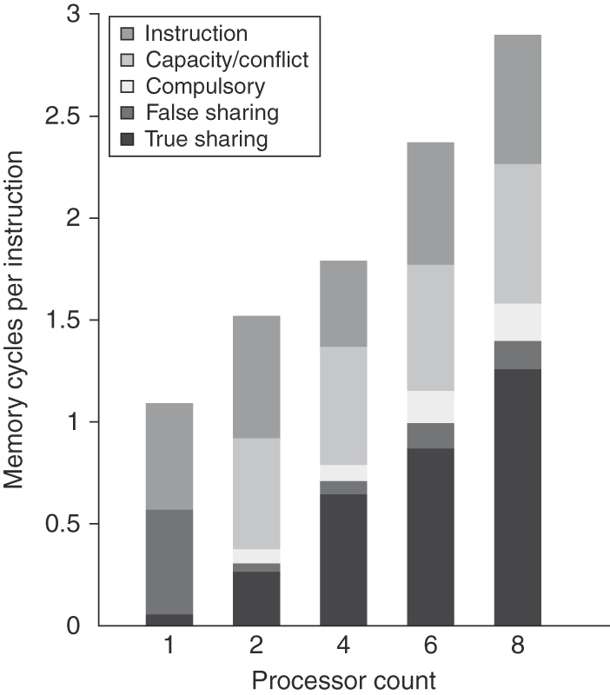
Figure 5.12 The contribution to memory access cycles increases as processor count increases primarily due to increased true sharing. The Compulsory misses slightly increase since each processor must now handle more compulsory misses.
Computer School, NUDT. Fall, 2018

Slide 89
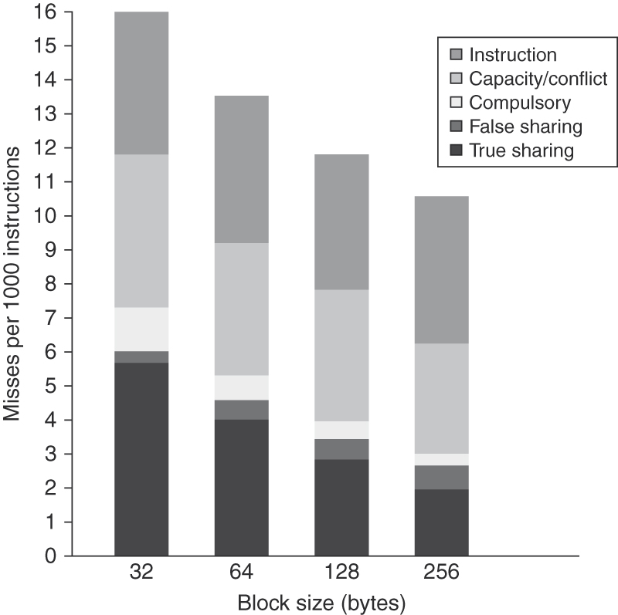
Figure 5.13 The number of misses per 1000 instructions drops steadily as the block size of the L3 cache is increased,making a good case for an L3 block size of at least 128 bytes. The L3 cache is 2 MB, two-way set associative.
Computer School, NUDT. Fall, 2018

Slide 90
Performance of the Multiprogramming and OS Workload
The misses can be broken into three significant classes:
1. Compulsory, or cold, misses represent the first access to this block by this processor and are significant in this workload.
2.Coherence misses represent misses due to invalidations.
3.Normal capacity misses include misses caused by interference between the OS and the user process and between multiple user processes. Conflict misses are included in this category.
Computer School, NUDT. Fall, 2018

Slide 91
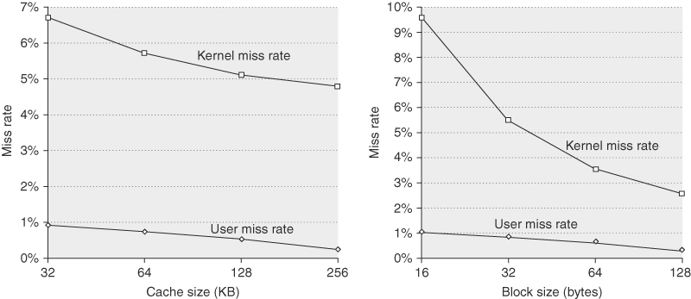
Figure 5.15 The data miss rates for the user and kernel components behave differently for increases in the L1 data cache size (on the left) versus increases in the L1 data cache block size (on the right). Increasing the L1 data cache from 32 KB to 256 KB (with a 32-byte block) causes the user miss rate to decrease proportionately more than the kernel miss rate: the user-level miss rate drops by almost a factor of 3, while the kernel-level miss rate drops only by a factor of 1.3. The miss rate for both user and kernel components drops steadily as the L1 block size is increased (while keeping the L1 cache at 32 KB). In contrast to the effects of increasing the cache size, increasing the block size improves the kernel miss rate more significantly (just under a factor of 4 for the kernel references when going from 16-byte to 128-byte blocks versus just under a factor of 3 for the user references).
Computer School, NUDT. Fall, 2018

Slide 92
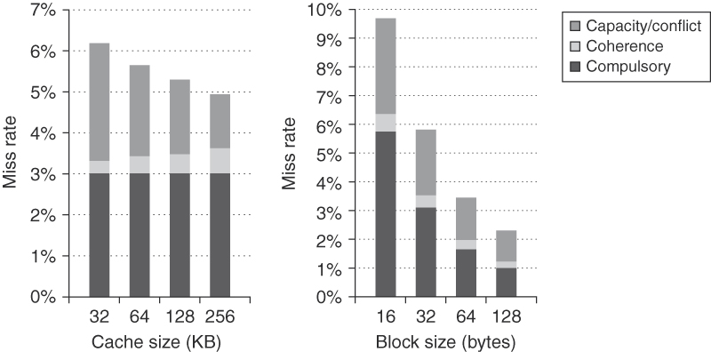
Figure 5.16 The components of the kernel data miss rate change as the L1 data cache size is increased from 32 KB to 256 KB, when the multiprogramming workload is run on eight processors. The compulsory miss rate component stays constant, since it is unaffected by cache size. The capacity component drops by more than a factor of 2, while the coherence component nearly doubles. The increase in coherence misses occurs because the probability of a miss being caused by an invalidation increases with cache size, since fewer entries are bumped due to capacity. As we would expect, the increasing block size of the L1 data cache substantially reduces the compulsory miss rate in the kernel references. It also has a significant impact on the capacity miss rate, decreasing it by a factor of 2.4 over the range of block sizes. The increased block size has a small reduction in coherence traffic, which appears to stabilize at 64 bytes, with no change in the coherence miss rate in going to 128 byte lines. Because there are no significant reductions in the coherence miss rate as the block size increases, the fraction of the miss rate due to coherence grows from about 7% to about 15%.
Computer School, NUDT. Fall, 2018

Slide 93
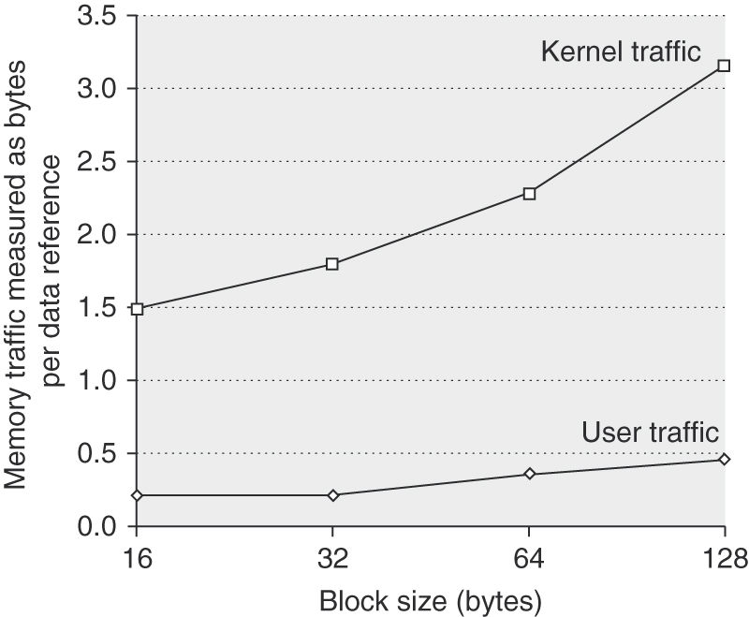
Figure 5.17 The number of bytes needed per data reference grows as block size is increased for both the kernel and user components. It is interesting to compare this chart against the data on scientific programs shown in Appendix I.
Computer School, NUDT. Fall, 2018

Slide 94
Performance for the Scientific/Technical Workload
We use a simulator to study the performance of our four scientific parallel programs. For these measurements, the problem sizes are as follows:
1. Barnes-Hut: 16K bodies run for six time steps (the accuracy control is set to1.0, a typical, realistic value);
2.FFT: 1 million complex data points
3. LU: A 512 × 512 matrix is used with 16 × 16 blocks
4.Ocean: A 130 × 130 grid with a typical error tolerance
Computer School, NUDT. Fall, 2018

Slide 95
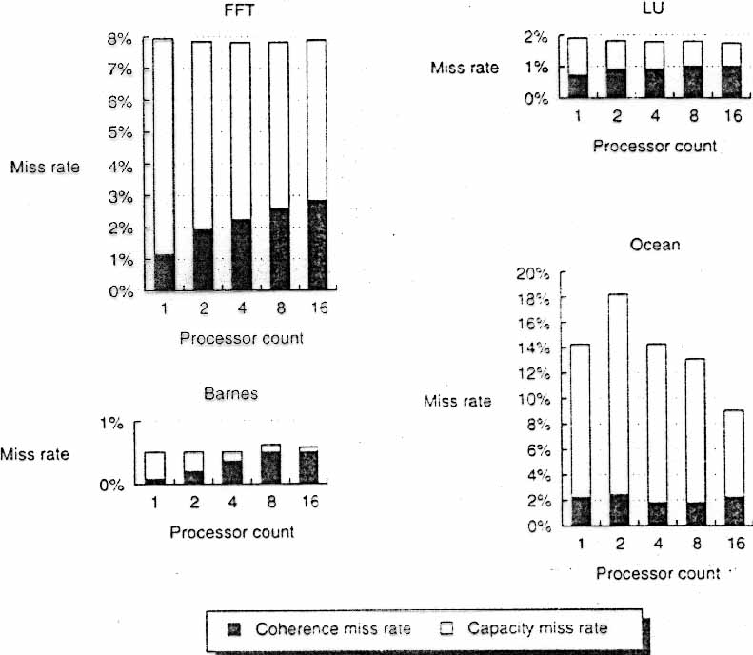
FIGURE: Data miss rates
Computer School, NUDT. Fall, 2018

Slide 96
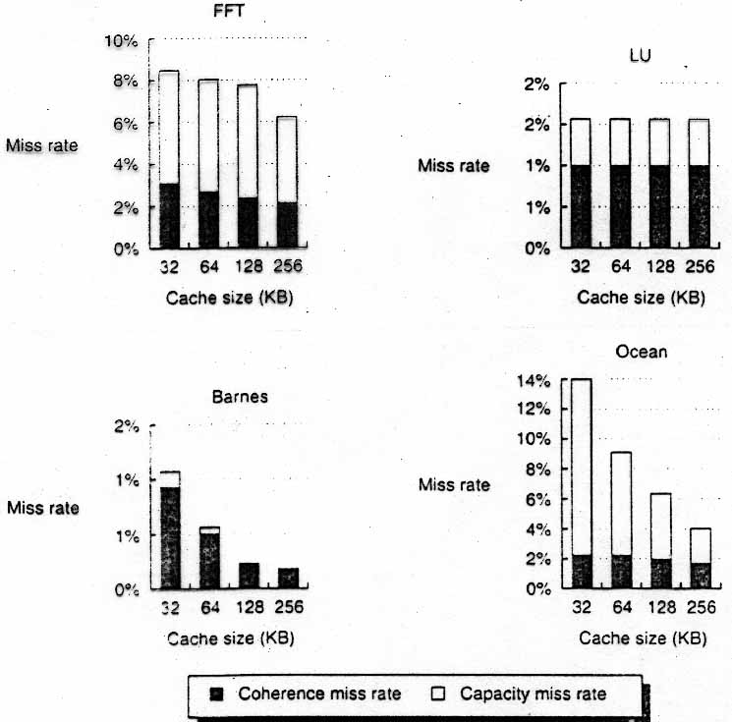
FIGURE: The miss rate usually drops as the cache size is increased
Computer School, NUDT. Fall, 2018

Slide 97
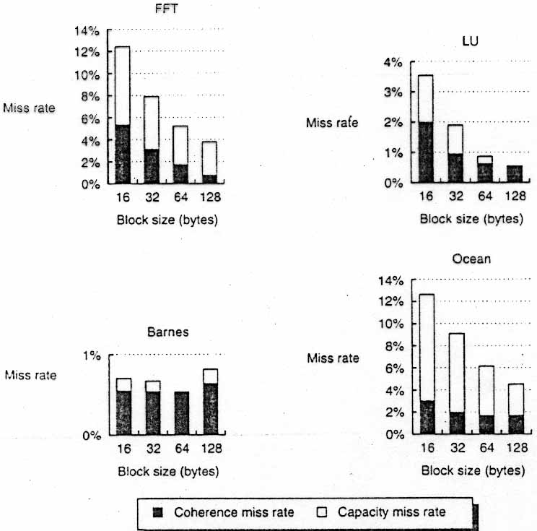
FIGURE: The data miss rate drops as the cache block size is increased
Computer School, NUDT. Fall, 2018

Slide 98
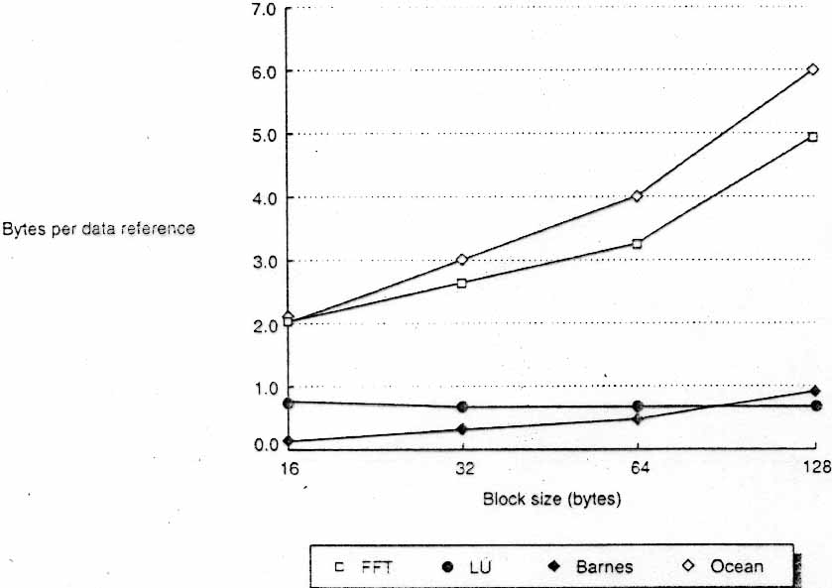
FIGURE: Bus traffic for data misses climbs steadily as the block size
Computer School, NUDT. Fall, 2018

Slide 99
Summary: Performance of Snooping Cache Schemes
In this section we examined the cache performance of three very different workloads.
We saw that the coherence traffic can introduce new behaviors in the memory system that do not respond as easily to changes in cache size or block size that are normally used to improve uniprocessor cache performance.
Computer School, NUDT. Fall, 2018

Slide 100
In the commercial workload, the performance of the web searching and DSS benchmarks is reasonable (CPI of 1.3 and 1.6, respectively), while the OLTP benchmark is much worse (CPI=7.0).
In the multiprogrammed workload, the user and OS portions perform very differently, although neither has significant coherence traffic.
Coherence requests are a significant but not overwhelming component in the scientific processing workload.
Computer School, NUDT. Fall, 2018

